Slide 1

Mental health
Social relationships
Academic engagement
Achievement
outcomes

Slide 2
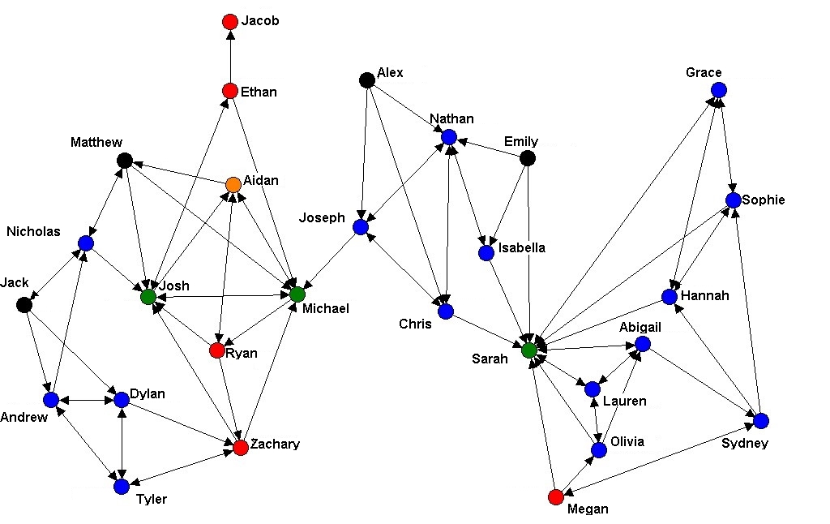

Kalani
Rio
Mei
Amaya
Kiri
Rahul
Nadia
Kai
Tanis

Slide 3
Banerjee et al. (2016)
Specialist staff and services
Curriculum
Individual pupil
Socio-emotional difficulties
Emotional
health
Whole school
Small group
Social and
emotional
learning
Pedagogical approach
School systems and climate
Classroom
Focal outcome
Level of operation
Area of activity

Slide 4
Wellbeing
Relationships
Participation

Slide 5
PHE report (2014, p. 4)
  Pupils with better health and wellbeing are likely to achieve better academically.
  Effective social and emotional competencies are associated with greater health and wellbeing, and better achievement.
  The culture, ethos and environment of a school influences the health and wellbeing of pupils and their readiness to learn.
  A positive association exists between academic attainment and physical activity levels of pupils.

Slide 6
The everyday environment matters
Inclusive music projects creating opportunities for psychological growth in marginalised young people
Key ingredients:
  Self-expression and exploration
  Freedom of choice
  Validation of competence with appropriate challenge
  Social bonding and community building
Levstek & Banerjee (2021)
Levstek, Barnby, Pocock, & Banerjee (2021)

Slide 7





Whole School Approach to Mental Health
Procter, Roberts, Macdonald, Randell, & Banerjee (2021)

Slide 8
