Slide 1
Cwricwlwm i Gymru Curriculum for Wales
14-16 learning under Curriculum for Wales
Dysgu 14-16 o dan Cwricwlwm i Gymru
Alun Jones
Ymgynghorydd Proffesiynol / Professional Advisor
Llywodraeth Cymru / Welsh Government
alun.jones049@gov.wales

Slide 2
Points to cover
New qualifications – update
WG consultation – 14-16 Learning under CfW
Context and change management - Leadership

Slide 3
Qualifications Reform
QW published decisions report on new Made for Wales GCSEs (June 2023)
WJEC now engaging in design and writing work – Consultation now live on ‘high level’ specification outlines
QW Full Qualifications Offer consultation closed in June 2023
GCSEs will be ready for first teaching 2025
The remaining elements of the Full Offer will be ready for first teaching from 2027

Slide 4
Context
CfW legislation
For each learner in years 10 and 11 the curriculum must be implemented in a way that secures learning and teaching:
in each Area. Not everything in the statements of what matters for each Area needs to be included, but all Areas need to form part of the curriculum. This is the only difference for this cohort
for RSE, is suitable for the learner’s stage of development
for RVE accords with curriculum design requirements
develops the mandatory cross-curricular skills
Careers and Work-Related Experiences (CWRE)

Slide 5
Change Management – Leadership
Structure / design of 14-16 curriculum offer
Professional Learning for subject teachers
Meeting the CfW statutory obligations
Ensuring that learners continue to develop towards the 4 Purposes
Continuation of the 3-16 vision
Impact on teaching and learning
The curriculum ‘offer’ for learners
The curriculum structure
CfW statutory obligations and the 14-16 Guidance
Teaching and learning

Slide 6
14-16 learning must…
Enable all learners, and in particular those from disadvantaged backgrounds, to progress along their own learning pathway and raise their aspirations to achieve their full potential
Enable all learners to be fully informed, advised and supported in respect of their post-16 next steps
Be a natural part of the 3-16 continuum under 3-16 (not create a ‘break’ or change in ethos at 14)
Ensure that all learners continue to make progress towards the four purposes

Slide 7
Policy drivers:
what are our new expectations for learning?
Curriculum for Wales mandates learning in RSE and RVE, and across all six Areas, up to 16; CWRE is embedded throughout; focus on learning experiences, as well as knowledge and skills
Importance of personal reflection: improving learning effectiveness and developing this essential life skill; practically this can help young people prepare for employment/education applications
Hefin David review and the VQ review both emphasise the need for employers and FE colleges to engage more actively with schools to support learners in their next steps; learners to receive open and tailored advice
Employability and disadvantage: CfW learners should be more employable having developed a broader set of skills, capacities and dispositions; there should be fewer young people who are NEET

Slide 8
Plans to consult
‘14-16 learning within CfW’ guidance – consultation - spring term.
Will help schools to understand:
we value more than just qualifications within 14-16 – focus on lifelong learning and preparing learners for post-16
how they could approach their curriculum offer / structure given the QW decisions on qualifications
how that looks in 2025 and 2027 respectively (‘Full qualifications offer’ from 2027)
Will also inform WG proposals on what should be included in the new school information landscape, and what should be used for evaluation and improvement purposes

Slide 9
The four purposes
Any 14-16 Policy must support schools in satisfying their statutory requirements.
When we consider any learning and experiences within the 14-16 space, they should ensure progression towards the four purposes in accordance with the mandatory principles of progression .
Learners setting themselves high standards, becoming effective communicators and building their understanding
Learners being innovative and creative as they approach their learning and experiences.
Collaborating effectively and being focused on helping others.
Developing positive relationships, building emotional and mental wellbeing and growing independence.
Understanding importance of diet and a healthy lifestyle
Learners who can engage with contemporary issues and who are progressing as respectful and responsible citizens

Slide 10
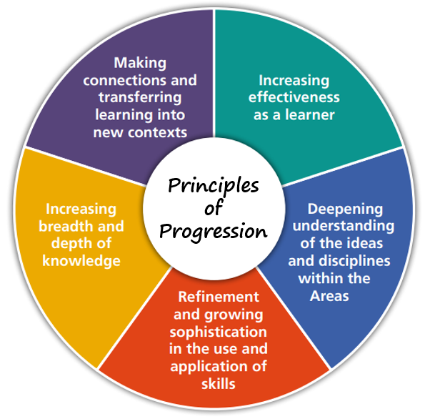
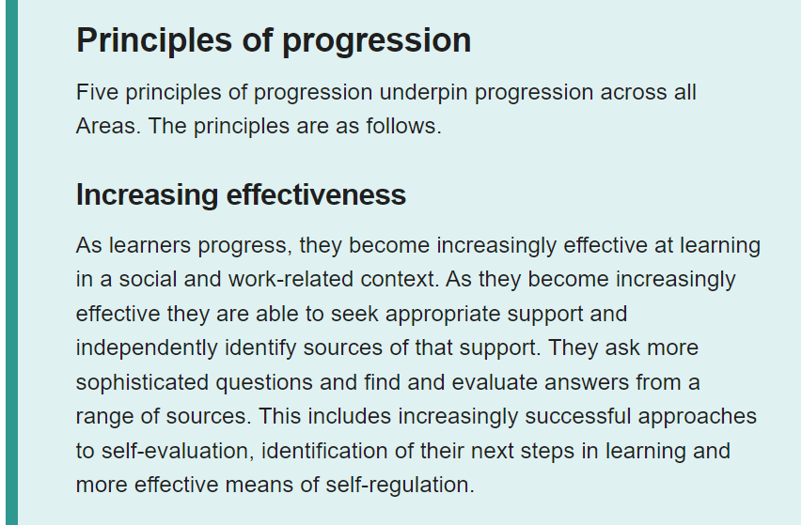
14-16 Guidance

Slide 11
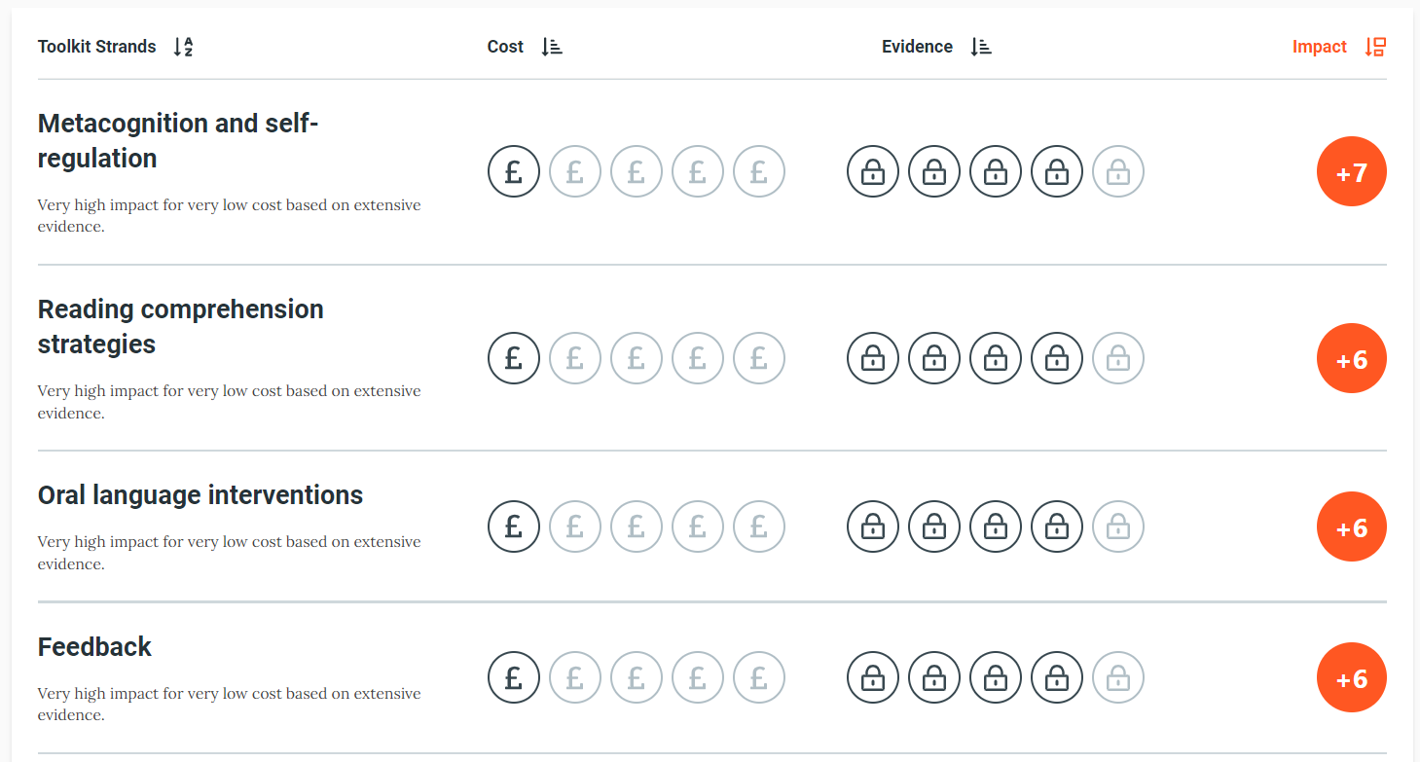
Investing in the right thing

Slide 12
Reflection on learning and planning for post-16
Schools are supporting learners to become increasingly effective - they will therefore need to ensure that learners are supported to reflect on their strengths and areas for improvement.
This might include:
Consideration of requirements for post-16 pathways (qualifications, skills, attributes and characteristics);
Identifying areas for additional support / challenge, and setting a clear plan for progress;
Building a holistic understanding of their learning, progression and achievements, and considering how these will support them in the future;
Reflecting on aspects of their learning within certain disciplines, and considering how these might link with other learning and experiences (inside and outside school);
Reflecting on aspects of their lives outside of school and considering things which help / hinder their progress.

Slide 13
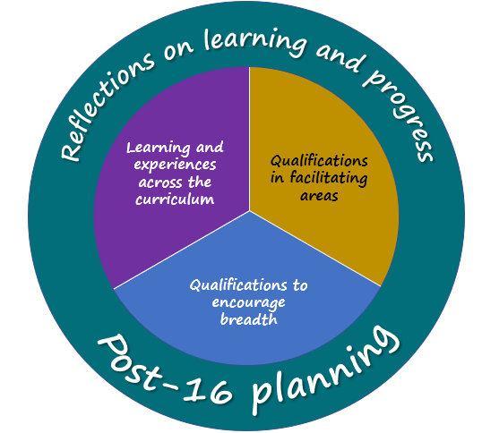
Qualifications in facilitating areas
Appropriate and ambitious courses of study in areas where all learners need to demonstrate attainment to facilitate smoother onward progression.
Qualifications in other areas
A wider set of courses of study from which learners can choose, as they begin to specialise
Support career pathways but maintain a breadth of learning
Appropriate mix of general and vocational qualifications
Other learning and experiences
Securing learning in all areas of the curriculum, must include RSE and RVE, CWRE: clear improvement in engagement from employers and colleges
Some of this learning can result in accredited units which can lead to a qualification (e.g. SCC / Skills Suite)
Independent learning e.g. Individual Project
Other learning and experiences e.g. Duke of Edinburgh
Post 16 planning and reflections on learning
Curriculum time for reflection on learning, progress and achievements.
Time to plan for post-16
Learner Portfolio to support?
Draws together all aspects above.
Learning and experiences across the curriculum
Qualifications in areas of specialism
Discussion:
Do you agree with this structure and broadly what's included as important?

Slide 14
What might this look like for a learner?
Example…
Curriculum time allocation is provided to stimulate discussion
Qualifications in facilitating areas | Qualifications to encourage breadth | Wider learning and experiences | Reflection and planning
50% | 35% | 10% | 5%
Learning and experiences across the curriculum
Reflections on Learning and Progress across the curriculum
Discussion questions
How do we enable / empower schools to make decisions based on the best interests of the learner?
How do we safeguard that the decisions made are securing a sufficiently challenging curriculum, allowing learners to reach their potential?
How can we empower schools to make the most of the purple and green sections, and what might the implications be for school timetables?

Slide 15
Information
Schools will need to design their curriculum so that all learners undertake effective, meaningful learning across the four components, supporting them to achieve and realise their aspirations.
Information expectations should reinforce the above (and support self-evaluation /improvement) whilst not driving a tick-box approach.
Discussion questions
What sort of information and evidence would support schools in this regard?
What do we think other stakeholders would want to know / understand about 14-16?

Slide 16
How can information and evidence support improvement?
Example questions
To what extent are learners reaching their potential? How has this been identified?
How do our expectations and outcomes compare with others in similar contexts?
Are we challenging learners sufficiently in terms of course choice / level etc?
How well do the reflection and self-evaluation processes support improvement?
How well are learners able to talk about their strengths and areas for improvement?
To what extent are learners able to talk effectively about their learning and progress?
How effective are they ‘as learners’?
How well are learners being supported to reach their potential?
Do learners set themselves high standards?
To what extent do learners feel prepared for post-16 transition?
What is the quality of the CWRE? To what extent do learners benefit from that?
To what extent do learners benefit from relevant, appropriate, meaningful support?
To what extent is the curriculum offer meeting the needs of all learners?
Are we challenging learners sufficiently in terms of course choice / level etc?
To what extent are learners reaching their potential? How has this been identified?
How do our expectations and outcomes compare with others in similar contexts?
To what extent are learners able to make connections between their learning and experiences?
To what extent can learners transfer their learning to new contexts?
To what extent do the learning and experiences contribute to a learner’s progression towards the 4Ps?
To what extent does the teaching impact on learning and progress?
To what extent does relationships with other partners / the wider community impact on learning and progress?

Slide 17
Workload
Proposal is in line with CfW expectations and wider expectations around next steps: many schools already do this in different ways
The ‘new’ element is the self-reflection: this is consistent with CfW but will need professional learning support
For schools:
can help them fulfil the requirements of CfW in a more efficient and joined-up way, whilst retaining flexibility
can provide a more coherent/equitable offer for young people around skills, CWRE, next steps
Discussion questions
What is the good practice on self-reflection / post-16 planning that already exists and how can we build on this?
What would be likely to be new or different in your schools, given the aspirations described?
What might this mean for managing teacher workload?

Slide 18
Diolch
Thank you
Alun Jones
Professional Advisor
Welsh Government
alun.jones049@gov.wales

